Slide 1


IDS 1721
Computing and Problem Solving for STEM
More While loop
Break statement

Slide 2
Simulating rolling dice
We want to simulate rolling two dice in MATLAB until both dice show a 6.
If both are 6, display "You Won!“
Otherwise, display "Try Again" and roll the dice again.
We continue rolling dice until we win.
Notes:
We can try to find areas A and B for several N, and find the error tolerance to have an idea
The n value can be printed using scientific notation
If the increment for n is increased before printing the value, then the wrong value will be displayed

Slide 3
Simulating rolling dice
How do we want to simulate rolling a dice?

Slide 4
Simulating rolling dice
How do we want to simulate rolling a dice?
Rolling a dice is a random process.
It’s similar to generating a random integer between 1 and 6

Slide 5
Simulating rolling dice
How to generate a random number in MATLAB?

Slide 6
How to Generate Random Numbers
How to generate a random number in MATLAB?
rand function
% A random number between 0 and 1
r = rand;

Slide 7
How to Generate Random Numbers
To simulate rolling a die we need a random integer between 1 and 6
How to generate Integers in a Range?
randi function
% A random integer between min and max
r = randi([min, max]);

Slide 8
Simulate rolling a die
To simulate rolling a die we need a random integer between 1 and 6
% A random integer between 1 and 6
r = randi([1, 6]);

Slide 9
Simulate rolling two dice
To simulate rolling two dice we need two random integer between 1 and 6:
dice1 = randi([1,6]);
dice2 = randi([1,6]);

Slide 10
Rolling two dice until a pair of 6s
Pseudocode:
Repeat the following as long as dice1 & dice2 are not 6:
Generate random integer between 1 and 6 for both dice1 and dice2
if (dice1 & dice2 are both 6)
Display "You Won!"
else
Display "Try Again"

Slide 11
Rolling two dice until a pair of 6s
How do we implement an iterative process?

Slide 12
Rolling two dice until a pair of 6s
How do we implement an iterative process?
for loops or while loops
Which iteration statement do you think we need to use for this problem? a for loop or a while loop? why?

Slide 13
Rolling two dice until a pair of 6s
How do we implement an iterative process?
for loops or while loops
Which iteration statement do you think we need to use for this problem? a for loop or a while loop? why?
while loop since we don’t know the exact number of iterations.

Slide 14
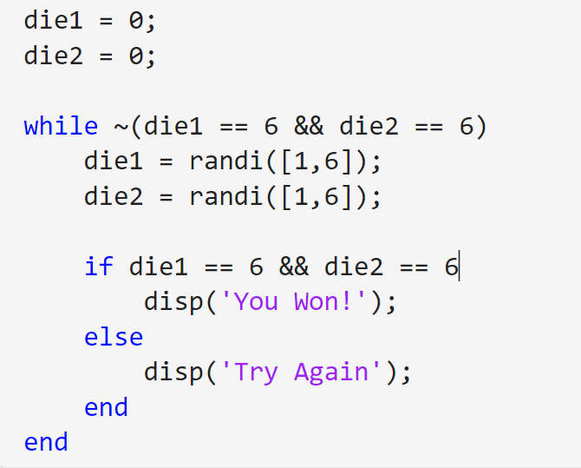
Rolling two dice until a pair of 6s
Code

Slide 15
Rolling two dice until a pair of 6s
Let’s change the game a bit. You only win if you get two 6s in the first 5 trials!
We want to simulate rolling two dice in MATLAB until both dice show a 6.
If both are 6, display "You Won!"
Otherwise, display "Try Again" and roll the dice again at most 4 more times.
If you don’t get a pair of 6s in your first 5 tries, display "Not lucky enough" and end the game

Slide 16
Rolling two dice until a pair of 6s
Pseudocode
Set attempt to 0
Repeat the following:
Roll die1 (random number between 1 and 6)
Roll die2 (random number between 1 and 6)
if die1 is 6 AND die2 is 6
Display "You Won!"
Exit loop
else
Display "Try Again"
Increment attempt by 1
if attempt equals 5
Display "Not lucky enough"
Exit loop

Slide 17
Rolling two dice until a pair of 6s
Pseudocode
Set attempt to 0
Repeat the following:
Roll die1 (random number between 1 and 6)
Roll die2 (random number between 1 and 6)
if die1 is 6 AND die2 is 6
Display "You Won!"
Exit loop
else
Display "Try Again"
Increment attempt by 1
if attempt equals 5
Display "Not lucky enough"
Exit loop
When do we exit the loop?
In two conditions:
if die1 is 6 AND die2 is 6
OR
if attempt equals 5

Slide 18
Rolling two dice until a pair of 6s
Pseudocode
Set attempt to 0
Repeat the following:
Roll die1 (random number between 1 and 6)
Roll die2 (random number between 1 and 6)
if die1 is 6 AND die2 is 6
Display "You Won!"
Exit loop
else
Display "Try Again"
Increment attempt by 1
if attempt equals 5
Display "Not lucky enough"
Exit loop
When do we exit the loop?
In two conditions:
if die1 is 6 AND die2 is 6
OR
if attempt equals 5
We can use break statement to exit the loop

Slide 19
Rolling two dice until a pair of 6s
break statement in MATLAB:
The break statement in MATLAB is used to exit a loop immediately, regardless of the loop’s remaining iterations or the loop's condition.
When MATLAB encounters a break statement inside a loop, it stops the execution of the loop and moves control to the line of code that follows the loop.
The break statement is commonly used within for and while loops.
It interrupts the normal flow of the loop when a specific condition is met.

Slide 20
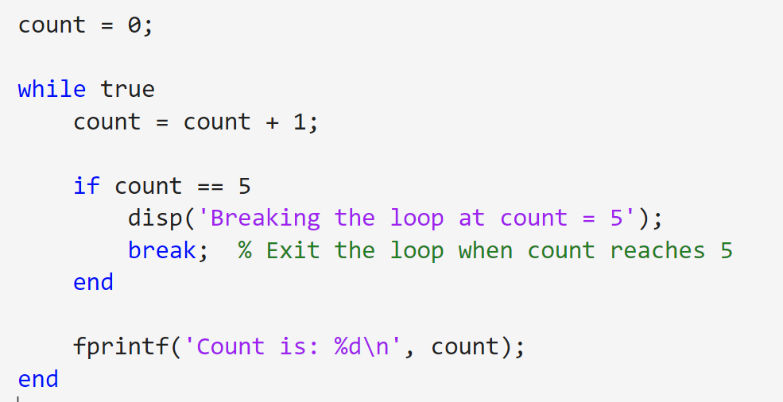
Rolling two dice until a pair of 6s
break statement in MATLAB:
if condition
break;
end
Example:

Slide 21
Rolling two dice until a pair of 6s
break statement in MATLAB:
Loop runs indefinitely
Exiting the loop after 5 iterations

Slide 22
Rolling two dice until a pair of 6s
Now, can you try implementing the rolling dice problem with 5 trial?

Slide 23
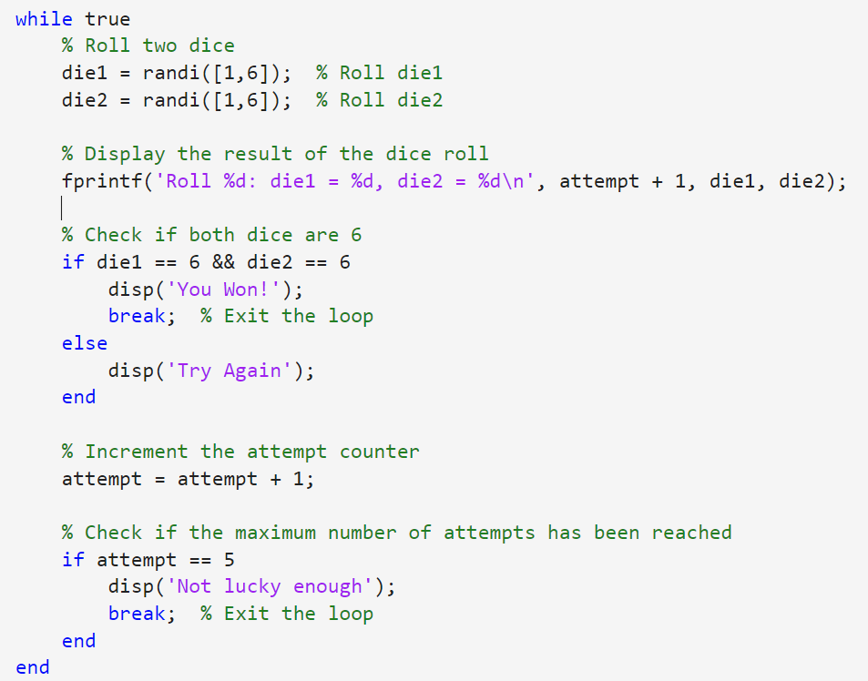
Rolling two dice until a pair of 6s
Code

Slide 24
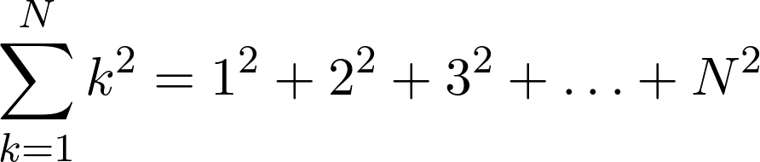
Let’s practice writing code to compute a sum in a for or while loop

Slide 25
Add k=3 term
to sum
Add k=1 term
to sum
Add k=N term
to sum
Add k=2 term
to sum
sum
The final result we wish to compute
Next slide: we add 0 to this, and arrange the terms vertically

Slide 27
sum = 0
Initialize sum to 0
sum = sum + 1²
Iteration 1: Add k=1 term
to sum
sum = sum + 2²
Iteration 2: Add k=2 term
to sum
sum = sum + 3²
Iteration 3:
Add k=3 term
to sum
sum = sum + N²
Iteration N:
Add k=N term
to sum

Slide 28
sum = 0
Initialize sum to 0
Updated value
Previous value
Iteration 1: Add k=1 term
to sum
sum = sum + 1²
Updated value
Iteration 2: Add k=2 term
to sum
sum = sum + 2²
Updated value
sum = sum + 3²
Iteration 3:
Add k=3 term
to sum
Updated value
Iteration N:
Add k=N term
to sum
sum = sum + N²

Slide 29
sum = 0 ;
Initialize sum to 0
for k=1:N
Updated value
sum = sum + k² ;
end
Iteration k:
Add k’th term
Previous value
Now sum is what we want

Slide 30
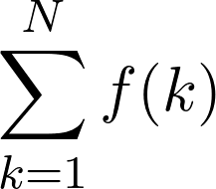




sum = 0
Initialize sum to 0
sum = sum +
Iteration 1: Add k=1 term
to sum
sum = sum +
Iteration 2: Add k=2 term
to sum
sum = sum +
Iteration 3:
Add k=3 term
to sum
sum = sum +
Iteration N:
Add k=N term
to sum

Slide 31
sum = 0
Initialize sum to 0
Updated value
Previous value
Iteration 1: Add k=1 term
to sum
sum = sum +
Updated value
Iteration 2: Add k=2 term
to sum
sum = sum +
Updated value
sum = sum +
Iteration 3:
Add k=3 term
to sum
Updated value
Iteration N:
Add k=N term
to sum
sum = sum +

Slide 32
sum = 0 ;
Initialize sum to 0
for k=1:N
Updated value
sum = sum + f(k);
end
Iteration k:
Add k’th term
Previous value
Now sum is what we want

Slide 33
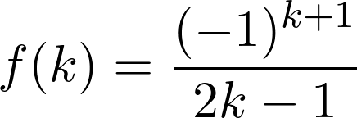
Now, imagine we have, in the previous, this function.

Slide 34
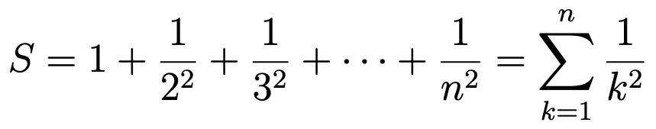
For practical purposes, we can only compute the sum for a finite number of terms.
Exercise: Write a psuedocode to find the above sum upto N terms where N is an user input.

Slide 35
Pseudocode
Get N
Initialize sum to 0
For k from 1 to N
sum = sum + 1/k²
End for
Display sum

Slide 36
In-Class Assignment - 02
Complete the In-class assignment 02 now
Due – at the end of the class.

